Slide 1
SmartPlant 3D Equipment Task

Slide 2
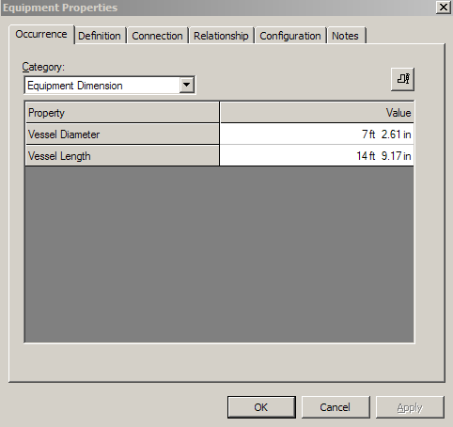
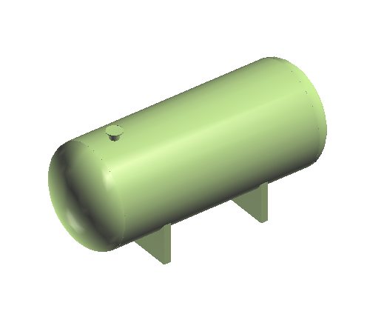
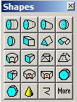
What is SmartPlant/Equipment
SmartPlant Equipment is an integrated equipment modeling environment that provides:
Parametric/Non-parametric Equipment Placement
Modeling of equipments using primitive shapes or equipment components
© 2005. Intergraph Corporation. All Rights Reserved.

Slide 3
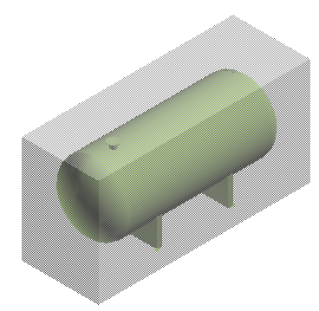
What is SmartPlant/Equipment
Equipment is a custom assembly that contains members (nozzles, shapes, equipment components, etc..)
Graphical representation of an Equipment can be created using:
  - Visual Basic (Geometry Type Functions)
  - 3rd party software – SAT format (Solid Edge v-16)
Aspects: Physical, Insulation, Maintenance, and so on …
Ports available:
  Piping port
  Ducting port
  Cabletray port
  Conduit port
  Cable port
  Foundation Port
© 2005. Intergraph Corporation. All Rights Reserved.

Slide 4

Equipment Task
Command Bar
  Select Tool
  Place Equipment
  Place Designed Equipment
  Place Equipment Component
  Place Designed Equipment Component
  Place Shape
  Place Nozzle
  Place Imported Shape from File
  Rotate Equipment
  Replace Equipment
  Place Designed Solid
© 2005. Intergraph Corporation. All Rights Reserved.

Slide 5
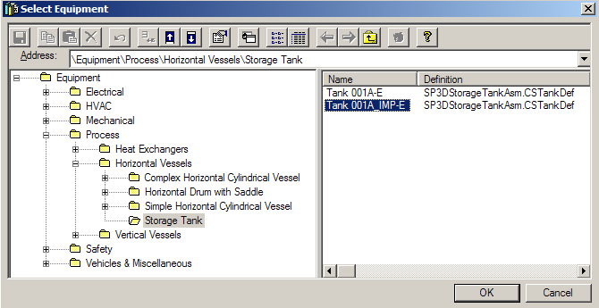
Place Equipment command
The place equipment command activates the Select Equipment dialog box (Catalog Browser) that provides access to equipment items that have been defined in the Reference Data
© 2005. Intergraph Corporation. All Rights Reserved.

Slide 6
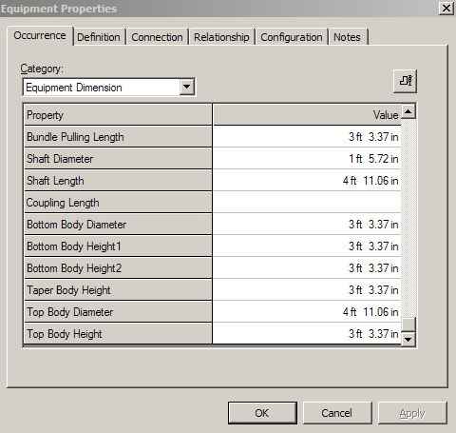
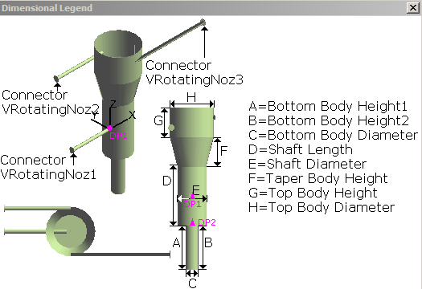
Equipment Properties
Occurrence Tab
Standard Category
  Name, System and other Standard properties
Position and Orientation Category
Insulation and Tracing Category
Equipment Dimension Category
Equipment Support Category
© 2005. Intergraph Corporation. All Rights Reserved.

Slide 7
Equipment Properties Page - cont
Definition Tab – Details of catalog data (not revisable normally
Connection Tab – Details of nozzles and other ports
Relationship Tab – Details of parents and children
Configuration Tab – Details of ownership and status
Notes Tab – User added data
© 2005. Intergraph Corporation. All Rights Reserved.

Slide 8
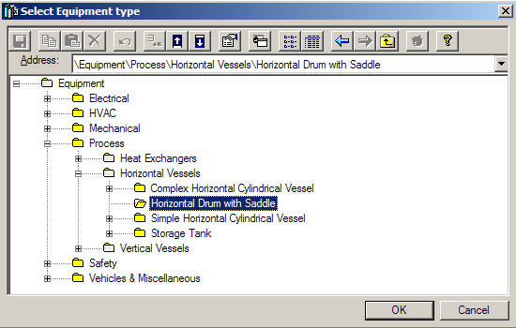
Place Designed Equipment command
The place designed equipment command activates the Select Equipment Type dialog box (Catalog Browser) that provides access to the designed equipment hierarchy

Slide 9
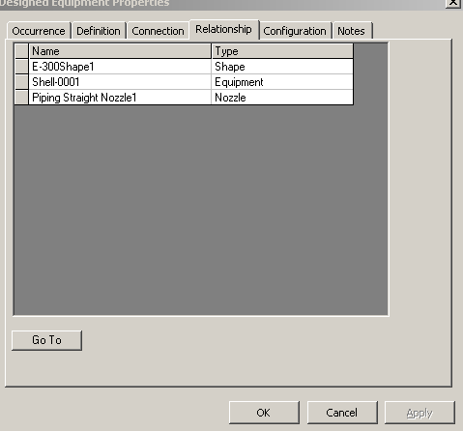
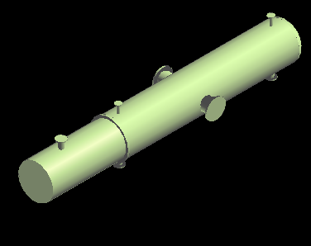
Design Equipment Properties Page
  Display shapes and ports on the relationship tab of the design equipment

Slide 10
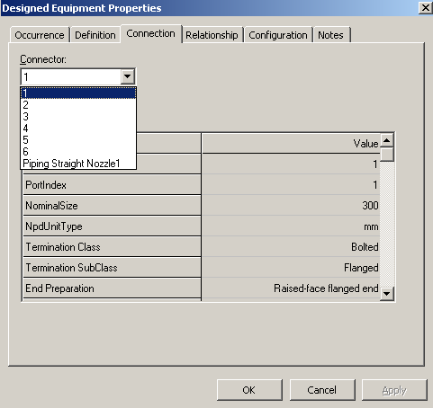
Design Equipment Properties Page
  Display all ports on the connection tab of the design equipment

Slide 11
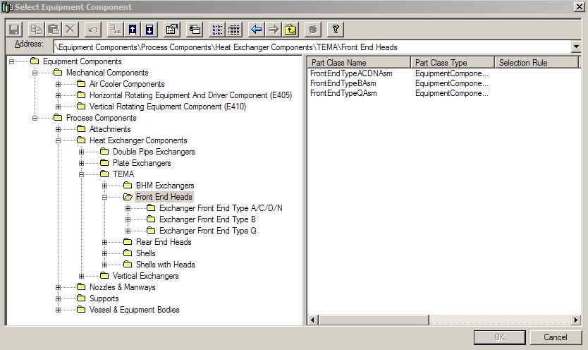
Place Equipment Component command
The place designed equipment command activates the Select Equipment Type dialog box (Catalog Browser) that provides access to the designed equipment hierarchy

Slide 12
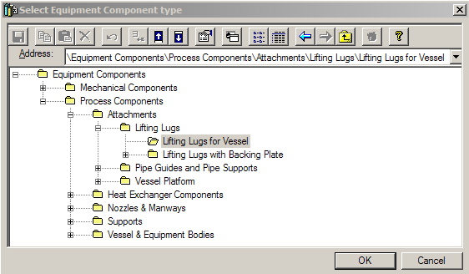
Designed Equipment Component command
The place designed equipment component command activates the Select Equipment Component Type dialog box (Catalog Browser) that provides access to the designed equipment component hierarchy

Slide 13
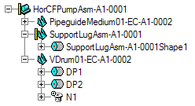
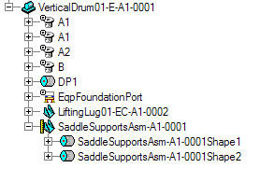
Catalog Equipment vs Designed Equipment
A Catalog Equipment simply becomes a programmatically defined designed equipment
A Designed Equipment is designed as placed
Designed Equipment Catalog Equipment
© 2005. Intergraph Corporation. All Rights Reserved.

Slide 14
Labs 1 and 2 – Place Equipment
© 2005. Intergraph Corporation. All Rights Reserved.

Slide 15
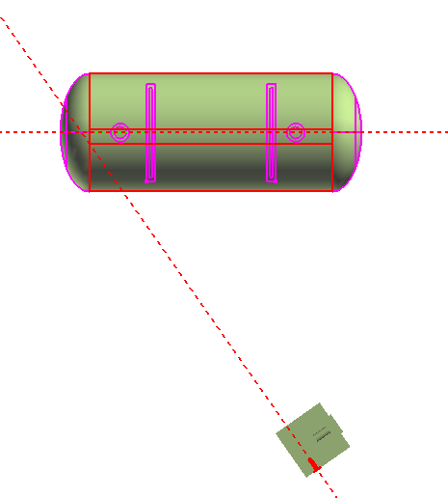
Equipment Task
Rotate Equipment
Reference on Rotation Object and Reference on Stationary Object steps
These steps allow user to define two reference lines
by selecting a surface, plane, or nozzle axis and then
system calculates the angle between these lines
3d Projection
Nozzle axis
© 2005. Intergraph Corporation. All Rights Reserved.

Slide 16
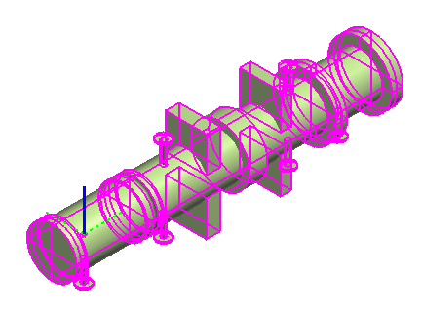
Equipment Task
Rotate Equipment
Use the Rotate Equipment Command
Use the Common Rotate Command
RotationAxis
© 2005. Intergraph Corporation. All Rights Reserved.

Slide 17
Equipment Task
Rotate Equipment
Identify/Change Rotation Axis
If the Equipment is constraint, only one choice is displayed (Perpendicular to the constraint plane)
RotationAxis
© 2005. Intergraph Corporation. All Rights Reserved.

Slide 18
Equipment Task
Rotate Equipment
Change the Rotation Point
The rotation point is the first foundation port of the equipment by default. If no foundation port exists, the origin of the equipment (local coordinate system origin) becomes the default point of rotation
© 2005. Intergraph Corporation. All Rights Reserved.

Slide 19
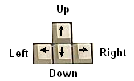
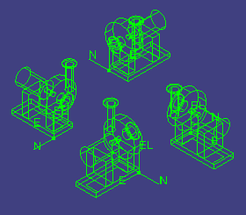
Equipment Task
Place Equipment Command
The arrow keys on the keyboard are to be used to rotate, and set the axis of rotation for any equipment object that supports a local coordinate system. These keys should work on initial placement of an object, as well as subsequent editing of objects
Up Arrow - change active axis in the recurring sequence of X, Y, Z
© 2005. Intergraph Corporation. All Rights Reserved.

Slide 20
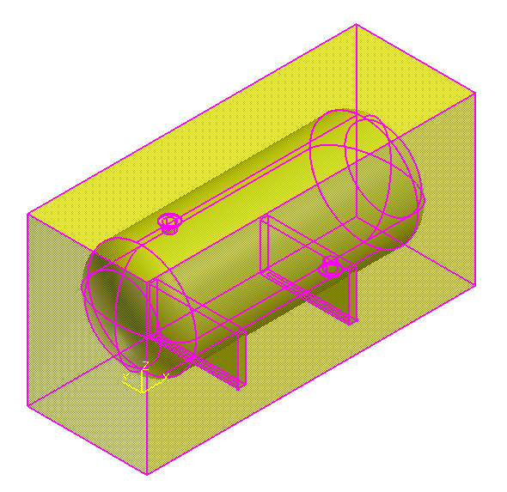
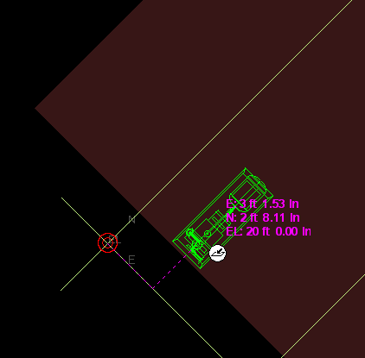
Equipment Task
Place Equipment Command
Use active coordinate system during placement
Equipment is placed using Symbol Origin by default
Rotated Coordinate System
origin
© 2005. Intergraph Corporation. All Rights Reserved.

Slide 21
Equipment Task
Place Equipment SmartStep Ribbon Bar
Name
Parent System
© 2005. Intergraph Corporation. All Rights Reserved.

Slide 22
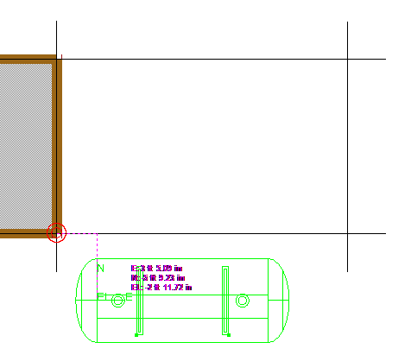
Equipment Task
PinPoint Tool
Provides coordinate inputs to the active command
x,y,z coordinates are relative to Target Point
Dynamically displays the coordinate/distance values
Lock the coordinate/distance values
Target Point
© 2005. Intergraph Corporation. All Rights Reserved.

Slide 23
Equipment Task
PinPoint Tool
Use the [F] keys to lock the coordinates from the cursor’s location
Supports of mathematical operations and reference plane names
Reposition
Target
[F12]
Set Target
to the origin of the current coordinate system
Display on/off current values [F9]
Relative Tracking
Toggle between rectangular/spherical /cylindrical.
Step values
E lock [F6]
N lock [F7]
EL lock [F8]
© 2005. Intergraph Corporation. All Rights Reserved.

Slide 24
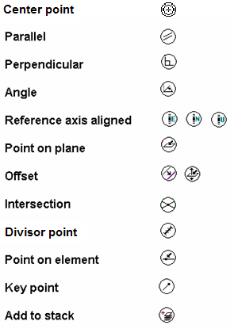
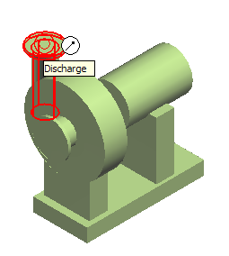
Equipment Task
SmartSketch
SmartSketch is the mechanism to automatically find special points when the command is looking for a point
© 2005. Intergraph Corporation. All Rights Reserved.

Slide 25
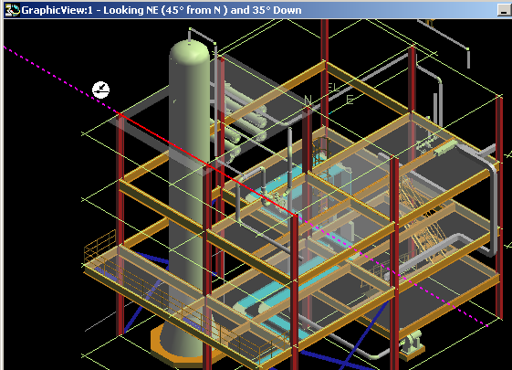
Equipment Task
SmartSketch
The system finds Key point and Point on geometry whenever you move the cursor over those points
System uses only those points (stored in the stack) and check for linear relationship points against every object in the workspace
© 2005. Intergraph Corporation. All Rights Reserved.

Slide 26
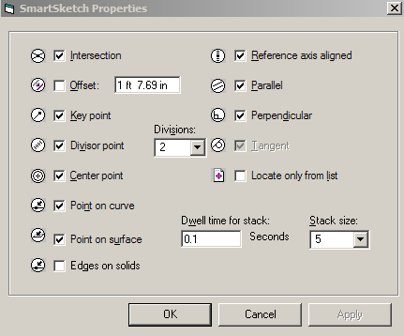
Equipment Task
SmartSketch Options
  Point on curve
  - 3D lines
  - 3D Arcs
  Point on surface
  - 3D Planes
  - 3D Projections
  - 3D Revolutions
  - 3D Cones
  - Ruled Surfaces & B-Splines
© 2005. Intergraph Corporation. All Rights Reserved.

Slide 27
Equipment Task
SmartSketch
SmartSketch Lock Constraint
When SmartSketch is being used, a middle mouse click will lock the currently active smartsketch constraint
- Middle mouse button
- Ctrl –L keys
© 2005. Intergraph Corporation. All Rights Reserved.

Slide 28

Equipment Task
SmartSketch
User will have two options on what objects are located by SmartSketch
- Locate on Display List
- Locate on List Only
Control –D Keys
SmartSketch Locate List Ribbon Bar
Set stack size
Clear stack
Toggle
Display/List only
Set time
© 2005. Intergraph Corporation. All Rights Reserved.

Slide 29
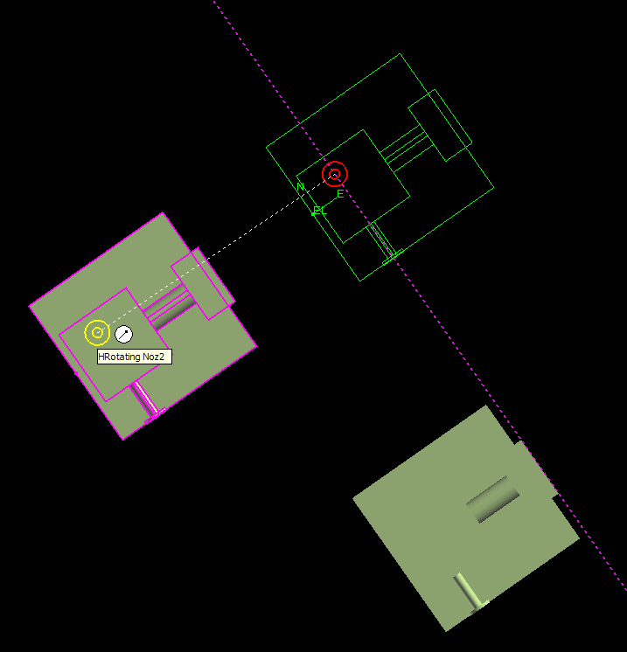
Equipment Task
Common Move command
Linear SmartSketch points are enabled in the move command. This functionality
allows easy movement along major axis/ or parallel to other objects
The origin of the item is used by default as
the Move From point
Move
To
Move
From
© 2005. Intergraph Corporation. All Rights Reserved.

Slide 30
Labs 3 – Place/Orientate Equipment
© 2005. Intergraph Corporation. All Rights Reserved.

Slide 31
Equipment Task
Place Designed Equipment Command
The place designed equipment command activates the Select Equipment Type dialog box (Catalog Browser) that provides access to the designed equipment hierarchy
© 2005. Intergraph Corporation. All Rights Reserved.

Slide 32
Equipment Task
Place Equipment Component Command
The place equipment component command activates the Select Equipment Component dialog box (Catalog Browser) that provides access to the equipment component hierarchy
© 2005. Intergraph Corporation. All Rights Reserved.

Slide 33
Equipment Task
Place Designed Equipment Component Command
The place designed equipment component command activates the Select Equipment Component Type dialog box (Catalog Browser) that provides access to the designed equipment component hierarchy
© 2005. Intergraph Corporation. All Rights Reserved.

Slide 34
Labs 4 – Place Designed Equipment and Components
© 2005. Intergraph Corporation. All Rights Reserved.

Slide 35
Equipment Task
Place Equipment SmartStep Ribbon Bar
Relationships/Constraints
Add constraints to further positioning the Equipment
Positioning relationships (constraints):
- Mate
- Align
- Connect
- Minimum Distance (E-W, N-S, Vertical)
- Parallel
- Mate to Tangent Plane
© 2005. Intergraph Corporation. All Rights Reserved.

Slide 36
Equipment Task
Place Equipment SmartStep Ribbon Bar
Set the Positioning Relationship
Shows the last relationship added in the relationship combo box
Offset distance
Steps
Positioning Relationship
Delete Relationship
© 2005. Intergraph Corporation. All Rights Reserved.

Slide 37
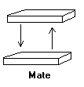
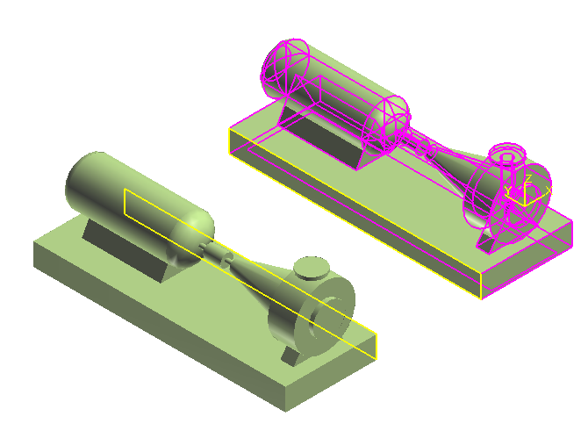
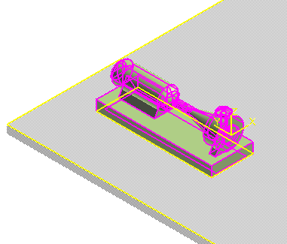
Equipment Task
Positioning Relationships
Mate Relationship
- Between planar surface and planar surface
- Surface Normal vectors point to each other
© 2005. Intergraph Corporation. All Rights Reserved.

Slide 38
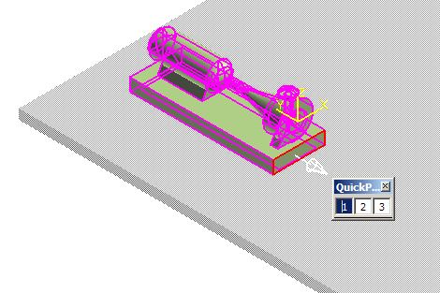
Equipment Task
Positioning Relationships
When the equipment is placed into the active workspace the default surface is automatically constraint to a surface selected in the workspace
If the equipment does not have a default surface defined, then the system uses an imaginary plane whose normal is along the local coordinate z-axis of the equipment symbol (origin)
Use Quick Pick toolbar to help you select the surface
When highlight surface for relationship, show surface direction vector
© 2005. Intergraph Corporation. All Rights Reserved.

Slide 39
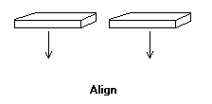
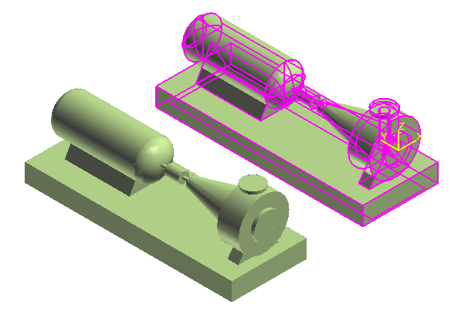
Equipment Task
Positioning Relationships
Align Relationship
- Between planar surface and planar surface
- Surface normal vectors point in the same direction
© 2005. Intergraph Corporation. All Rights Reserved.

Slide 40
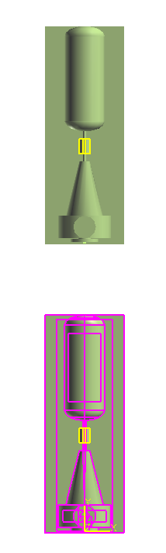
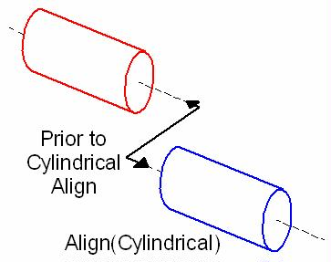
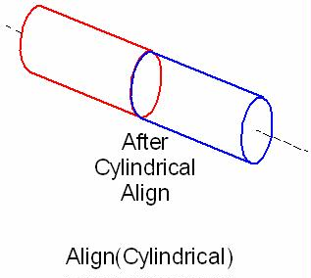
Equipment Task
Positioning Relationships
Mate/Align Relationship
- When you select cylindrical objects, the system uses the
axes to create the relationship
- Make the two axes collinear
© 2005. Intergraph Corporation. All Rights Reserved.

Slide 41
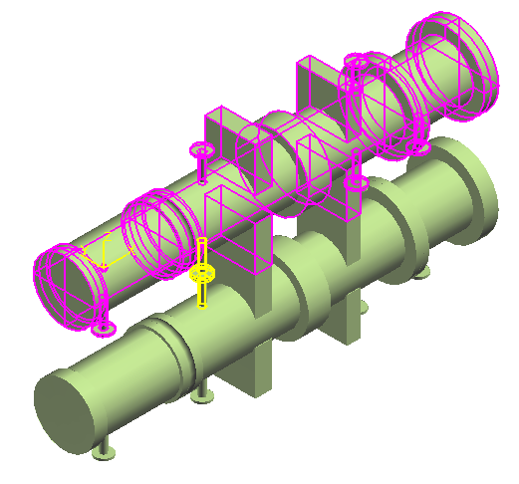
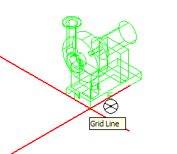
Equipment Task
Positioning Relationships
Connect Relationship
- Forces a port on an equipment to be coincident with a port on another equipment
- Implicit move command
© 2005. Intergraph Corporation. All Rights Reserved.

Slide 42
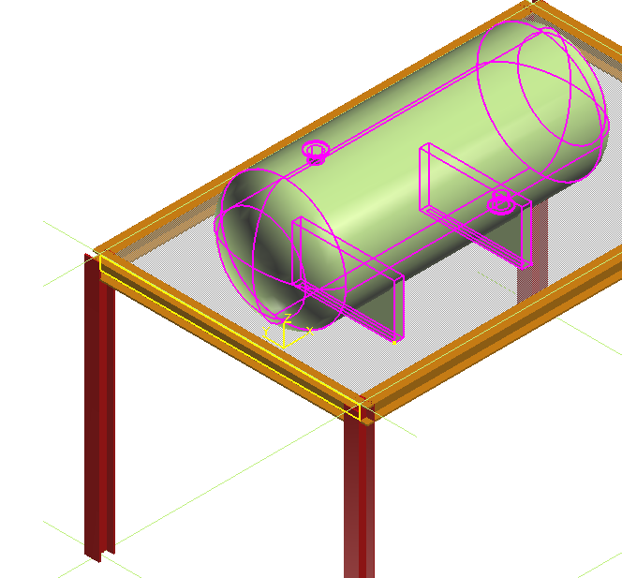
Equipment Task
Positioning Relationships
Minimum Distance Relationships (E-W, N-S, Vertical)
- Between 3D points and planar surface (example: 3D plane entities, slabs, etc)
3D Point
Surface
© 2005. Intergraph Corporation. All Rights Reserved.

Slide 43
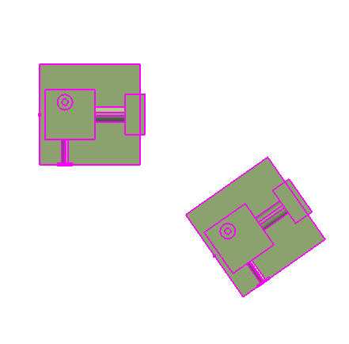
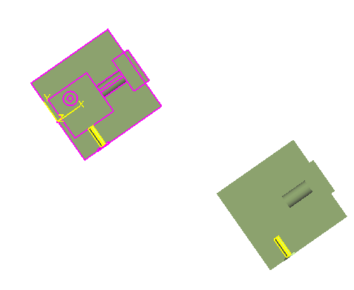
Equipment Task
Positioning Relationships
Parallel Relationship
- Only rotate the selected equipment to create the constraint
Axis
Axis
Before
After
© 2005. Intergraph Corporation. All Rights Reserved.

Slide 44
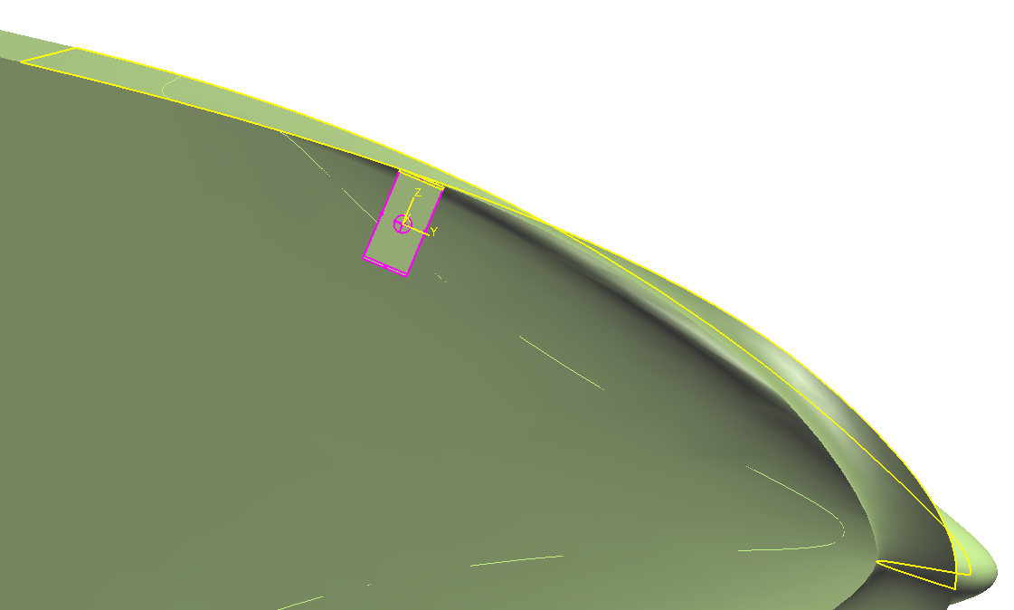
Equipment Task
Positioning Relationships
Mate to Tangent Plane Relationship
- constraint the equipment between a tangent plane created at the intersection of
a user-defined vector and a selected surface
Vector defined by two points
Mate Surface
Tangent Plane
© 2005. Intergraph Corporation. All Rights Reserved.

Slide 45
Labs 5 – Place Equipment with Relationship
© 2005. Intergraph Corporation. All Rights Reserved.

Slide 46
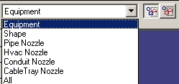
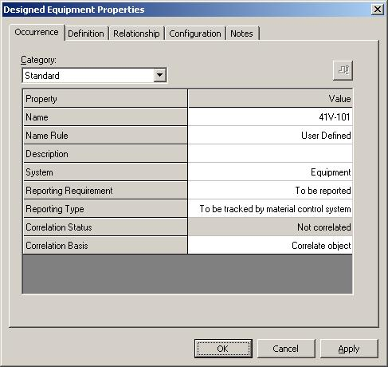
Manipulation Commands
Equipment Entities Manipulation
  Select Command
  Delete Command
  Undo Command
  Move Command
  Rotate Equipment
  Rotate Command
  Open properties Page
  Copy/Paste Command
  Mirror Copy command
  Copy to Catalog
  Paste from Catalog
© 2005. Intergraph Corporation. All Rights Reserved.

Slide 47
Labs 6 and 7 – Equipment Manipulation
© 2005. Intergraph Corporation. All Rights Reserved.

Slide 48
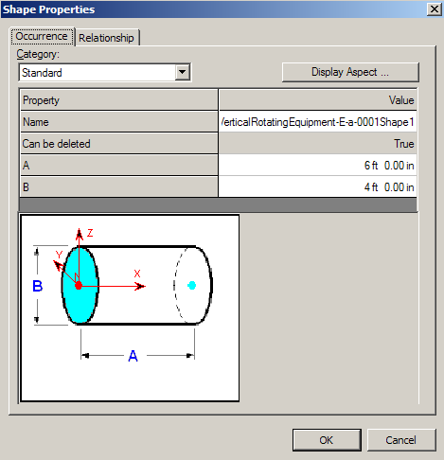

Equipment Task
Shapes
Customize palette
One-click placement
Activate Shape Reference step
Arrow keys for rotate during placement
PinPoint
Point Along
Relationships
© 2005. Intergraph Corporation. All Rights Reserved.

Slide 49
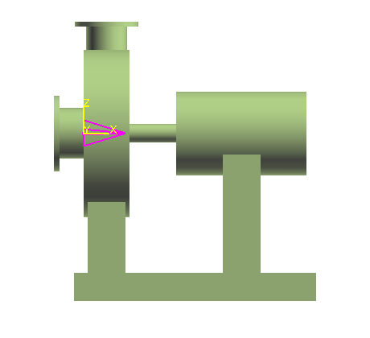

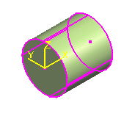
Equipment Task
Shapes
Place Shape using Symbol Origin by default
Shape (Datum Shape)
Catalog Equipments and Equipments Components come with datum shapes
Datum Shape
Origin
© 2005. Intergraph Corporation. All Rights Reserved.

Slide 50
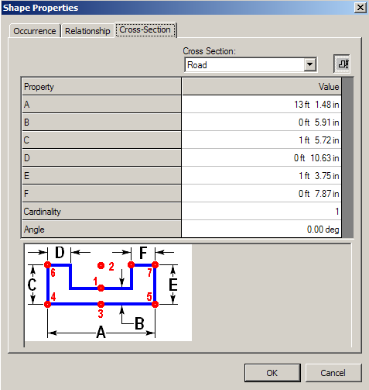
Equipment Task
Shapes
Availability of Prismatic Shapes
Prismatic Shape
© 2005. Intergraph Corporation. All Rights Reserved.

Slide 51
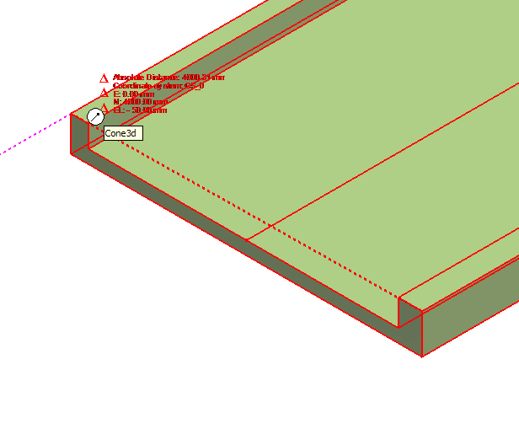
Equipment Task
Shapes
All surfaces (persisted) and edges are available on prismatic shapes
Prismatic Shape
© 2005. Intergraph Corporation. All Rights Reserved.

Slide 52
Equipment Task
Place Shape SmartStep Ribbon Bar
Relationships/Constraints
Add constraints to further positioning the shape
Positioning relationships (constraints):
- Mate
- Align
- Connect
and / or use
PinPoint
Point Along
© 2005. Intergraph Corporation. All Rights Reserved.

Slide 53
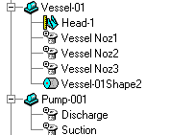
Equipment Task
Place Nozzle Command
All nozzles become First Class Business Object with their own
identity. They are not nested outputs of the symbol
Support occurrence properties for nozzles in catalog equipment
Positioning relative to Equipment, Equipment Component and Shapes
Ports are displayed in Workspace Explorer
© 2005. Intergraph Corporation. All Rights Reserved.

Slide 54


Equipment Task
Place Nozzle Command
Provide predefined nozzles (values) in catalog for placement
© 2005. Intergraph Corporation. All Rights Reserved.

Slide 55

Equipment Task
Place Nozzle Command
Port Type:
Piping Straight Nozzle
Piping Elbow Nozzle
Conduit port
Cabletray port
Cable port
Hvac port
Foundation port
Pipe Port (No Added Graphic)
Hvac Port (No Added Graphic)
© 2005. Intergraph Corporation. All Rights Reserved.

Slide 56

Equipment Task
Place Nozzle Command
Properties (Occurrence Tab)
Key properties are
Nominal Size
NPD units
Termination class
Termination subclass
End preparation
Schedule or Rating
  Design Practices
Nozzle Length
Nozzle Name
© 2005. Intergraph Corporation. All Rights Reserved.

Slide 57

Equipment Task
Place Nozzle Command
Placement Type:
Radial
Axial
Tangential
Skew
Offset Skew
Position by Plane and Axis
Position by Point
© 2005. Intergraph Corporation. All Rights Reserved.

Slide 58



Equipment Task
Nozzle Position and Orientation Properties
Equipment, Shape and Nozzle
Bearing readout from ACS North
© 2005. Intergraph Corporation. All Rights Reserved.

Slide 59

Nozzle Placement Port Type
  - Pipe Port (No Added Graphic)
  - Hvac Port (No Added Graphic)
  These options allow the user to pick a projection and a plane and key in an offset. The nozzle will then be placed such that the direction is inline with the axis of the projection and the surface is mated with the given offset to the plane selected.
© 2005. Intergraph Corporation. All Rights Reserved.

Slide 60
Labs 8 and 9 Building Design Equipment and Placing Nozzles
© 2005. Intergraph Corporation. All Rights Reserved.

Slide 61

Equipment Task
Place Imported Shape from File Command
This command imports the graphics from a SAT format file as the
geometry for a shape
ACIS Output File Format
The geometry will be converted to G-type format in the model
The shape’s origin is defined by the coordinate system of the SAT file
© 2005. Intergraph Corporation. All Rights Reserved.

Slide 62
Equipment Task
Replace Equipment Command
Exchanges a selected equipment or equipment component in the model for a different item from the catalog
System keeps the position and orientation properties the same
© 2005. Intergraph Corporation. All Rights Reserved.

Slide 63
Lab 10- Importing Equipment
© 2005. Intergraph Corporation. All Rights Reserved.

Slide 64



Solid Modeling
Solids will enable the user to use Add, Subtract and Suppress Boolean operations that will assist in creating complex shapes. Designed equipment command should be used to place the designed solid in the model. Multiple designed solids can be placed under single designed equipment. Multiple designed equipments also can be placed under single designed equipment.
  Shape A + Shape B
  Solid Merged Shape
Add Shape
  Shape A - Shape B
  Solid Subtracted Shape
Subtract Shape

Slide 65
Equipment Task
Summary - Modeling
Catalog Equipments and Designed Equipments have the same structure and the same persistence
Catalog Equipments can have optional members (managed by the CAD API)
Catalog Equipments can have interactively added shapes, nozzles, Equipment components etc… just like Designed Equipments
Designed Equipments have a symbol reduced to a single control point. Their parts are defined in the model
Designed Equipments require a placement point at creation time
Nozzles are filterable
© 2005. Intergraph Corporation. All Rights Reserved.

Slide 66
Equipment Task
Summary - Modeling
Equipment Components follow the same logic as Equipments
Equipment Components cannot be placed standalone, they must have an Equipment as parent
Equipment Components are Assemblies
Equipment Components cannot have children Equipment Components
Equipments cannot have children Equipments
Constraint system works on homogeneous object types:
  Equipment to Equipment
  Shape to Shape (for siblings of an Equipment or Equipment component)
  Equipment Component to Equipment Component (for siblings of an Equipment)
© 2005. Intergraph Corporation. All Rights Reserved.

Slide 67
Labs 11 and 12 – Optional Equipment build and Import from P&ID
© 2005. Intergraph Corporation. All Rights Reserved.

